Slide 1
History and Evolution of Computer
Lecture 4

Slide 2
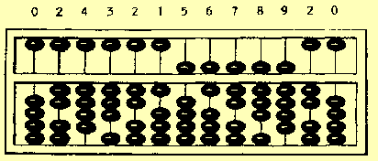
Evolution of Computers
The abacus is a manually operated digital computer used in ancient civilizations
The use of the word abacus dates before 1387 AD

Slide 3
Computer Generations
“Generation” in computer talk is a step in technology. It provides a framework for the growth of computer industry
Originally it was used to distinguish between various hardware technologies, but now it has been extended to include both hardware and software
Till today, there are five computer generations

Slide 4
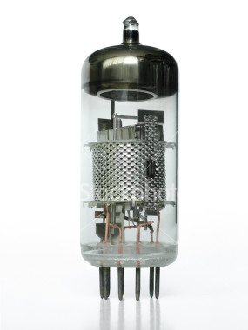
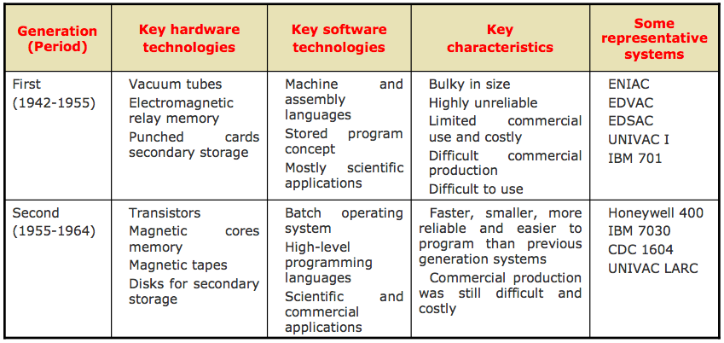
1st Generation Computer

Slide 5
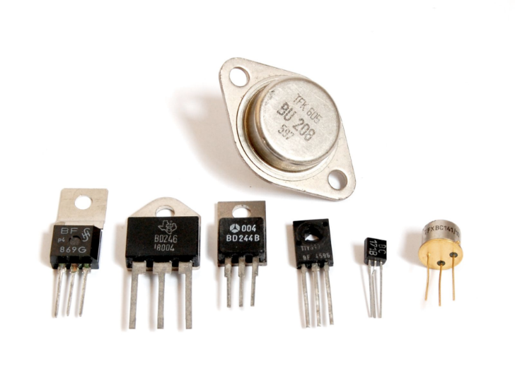
2nd Generation Computer

Slide 6
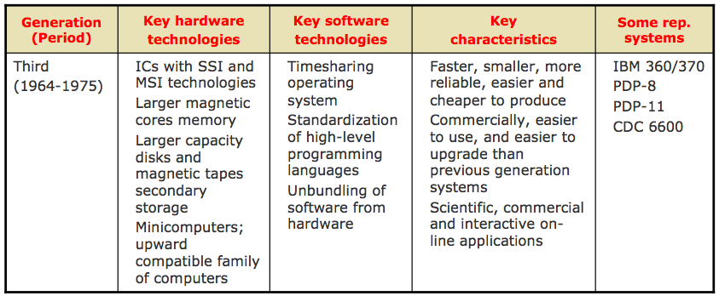
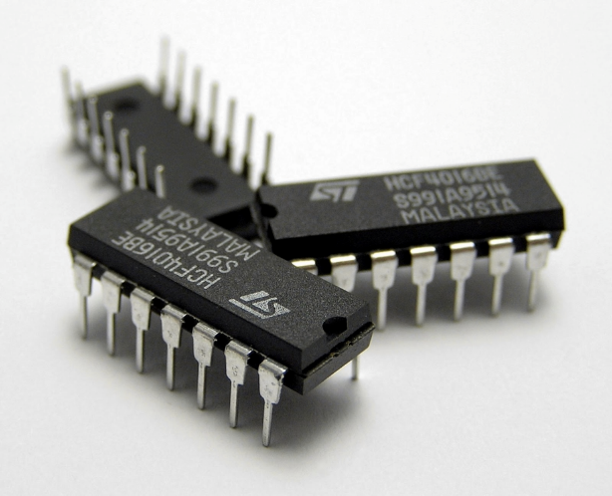
3rd Generation Computer

Slide 7
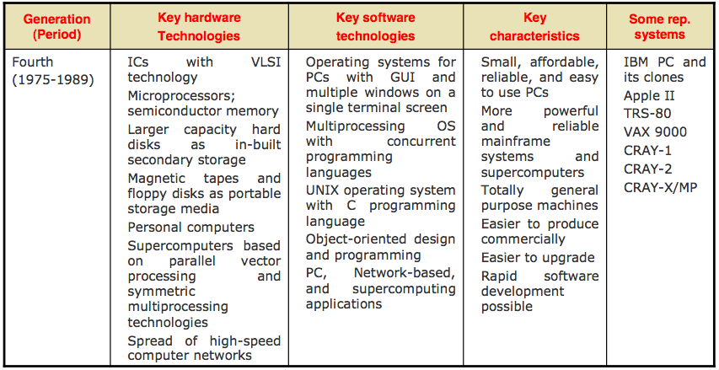
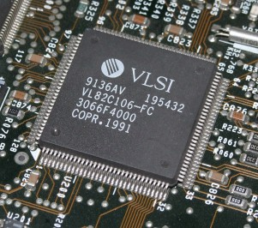
4th Generation Computer

Slide 8
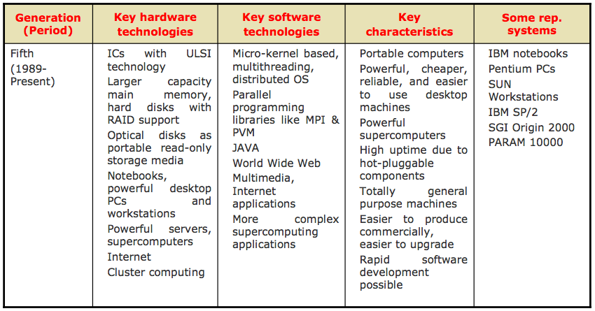
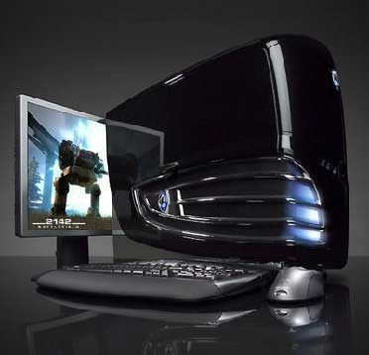
5th Generation Computer

